Slide 1
Building Shared Technology Governance
2022
Notes:
Good Afternoon!
Thank you for allowing Andrew Roderick and me to join this meeting. We are here to talk about Building Shared Technology Governance.
Andrew and I presenting this to all cabinet areas and other key stakeholders on campus.

Slide 2
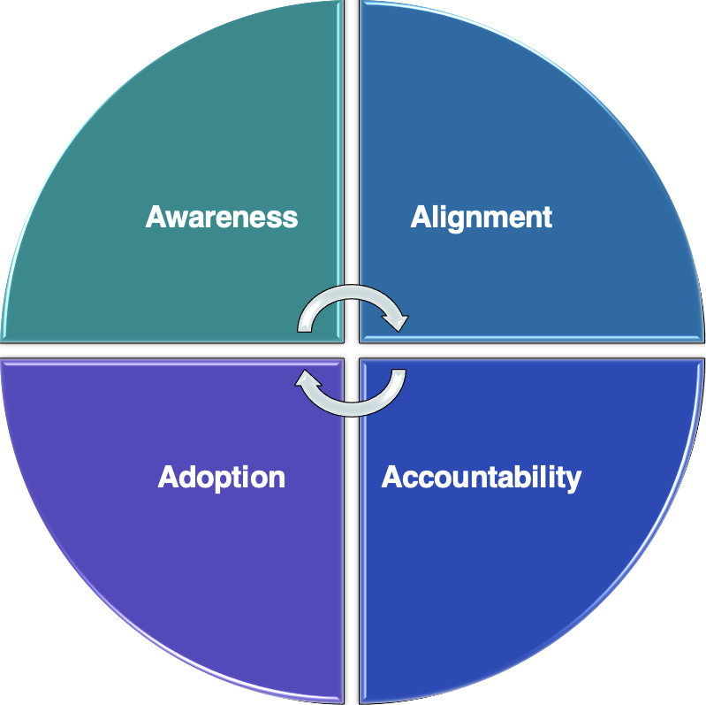
Why Shared Technology Governance
Focus of Shared Technology Governance
Strategic Alignment
University Needs & Core Mission
Policymaking
Decision Making
Oversight & Governance
Not the Focus
Policy & Decision Implementation
IT Operations
Informal Processes
Individual Needs
Request/Review Platform
Notes:
In October 2019, we had MB2 Consultants provide a strategic plan for aligning campus technology with the Academic Master Plan.
The MB2 plan included a recommendation for a campus technology governance body comprised of academic and business stakeholders who will advise and help us prioritize large technology projects.
Other Highlights included:
Improve alignment to strategic priorities
Allocate limited recourses towards higher value projects
Reduce expenditures on duplicative purchases like multiple CRMs from different vendors
Improve coordination between various campus technology and support providers
Improve coordination with procurement and budget resources

Slide 3
Shared Technology Governance Structure
Shared
Technology Governance
Steering Committee
Subcommittee
New Subcommittee
Working Group
Academic Technology Advisory
Information Security
Procurement
Applications & Services
Technical Architecture
Classroom Readiness
Payment Card
Service Management
Active Directory
InfoSec Community of Practice
Technology Acquisition Request
Notes:
Shared technology governance structure pulls together existing subcommittees
Click 1: creates additional subcommittees
Click 2: and supports them with existing and new technical working groups
Subcommittees and working groups are staffed by subject matter experts from across campus

Slide 4
Shared Technology Governance Flow Examples 1
Cabinet or Divisional Leadership
Shared
Technology Governance
Steering Committee
Subcommittee
New Subcommittee
Academic Technology Advisory
Procurement
Applications & Services
Information
Security
Technical Architecture
Colleges or Departments
Notes:
Example:
Click 1: Colleges or Departments
Click 2: ATAC and Procurement (implied TAR process)
Click 3:Technology Governance
Click 4:Cabinet or Divisional Leadership

Slide 5
Shared Technology Governance Flow Examples 2
Shared
Technology Governance
Steering Committee
Subcommittee
New Subcommittee
Academic Technology Advisory
Procurement
Applications & Services
Information Security
Technical Architecture
Financial Services
Notes:
Fiscal Affairs discovers a possible security issue
They might send an email to Mary Morshed, Senior Director Information Security
If Mary/Information Security team can resolve the matter at hand in coordination with other ITS teams that is great but if this is a bigger issue impacting the campus, she will engage the Information Security subcommittee who review, analyze, and recommend a solution
If the analysis leads to a high-impact policy change or large technology purchase, the analysis and recommendation is provided to the steering committee for review and decision

Slide 6
Timeline
Phase #1 (Spring 2022)
Socialize
Phase #2 (Summer 2022)
Organize
Phase #3 (Fall 2022)
Standardize
Phase #4 (Ongoing)
Normalize
Broad Engagements Present the shared technology governance framework Answer questions Demonstrate value
Subcommittees Organize Subcommittees form, and organize around, committee charge Standardize processes and communications Communicate processes to University community Campus Tour (What Tech. Governance Means)
First Committee Meeting Assemble the committee Committee defines schedule & commitment Draft and finalize the charge
Normalize Processes Review existing project work Begin accepting project requests Evaluate process effectiveness and adjust
Notes:
WHEN/Next Steps
The timeline provides an opportunity to gather constituent feedback that drives the final shape of the governance body
The initial membership will define the committee’s charge and determine the meeting schedule (Biggest worry among leadership will be frequency of the meetings)
Recommend monthly meetings to form and define the scope of the committee and then less frequently—maybe quarterly—once the committee is operational

Slide 7
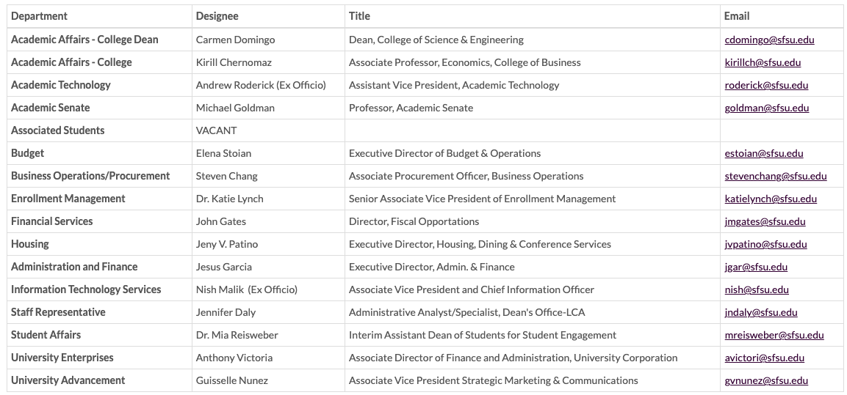
Shared Technology Governance Committee Members
Notes:
The Shared Technology Governance committee has membership drawn from all cabinet areas and nominated by the respective Vice Presidents.
We also have representation from student, faculty, and staff.
These committee members will rely on the expertise of the vast membership of supporting subcommittees that will have broad representation from the campus including Distributed IT, AT and ITS teams.

Slide 8
Questions?

